Slide 1

Course Id :INT 213

Slide 2
Strings
Sequence made up of one or more individual characters.
S = “welcome to python programming”
print(S)

Slide 3
Length of a String
S= “Python programming”
n= len(S)
print(n)

Slide 4
Indexing in Strings
Index represents the position number.
Index is written using square braces [].
By specifying the position number through an index, we can refer to the individual elements (or characters) of a string. For example, str[0] refers to the 0th element of the string and str[1] refers to the 1st element of the string.
Thus, str[i] can be used to refer to ith element of the string. Here, ‘i’ is called the string index because it is specifying the position number of the element in the string.

Slide 5
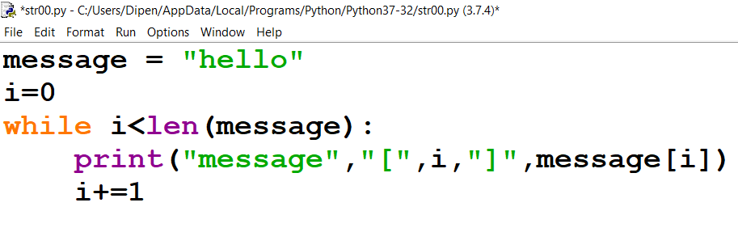
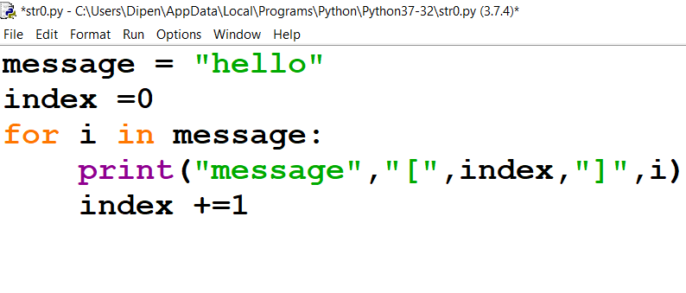
String Traversal
Using while Loop
Using For Loop

Slide 6
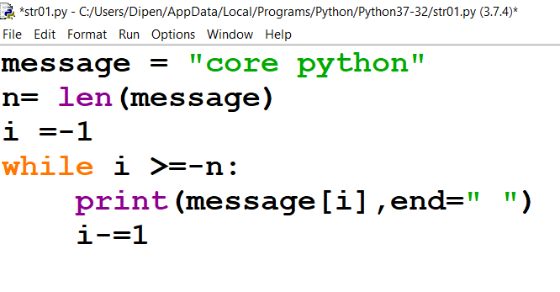
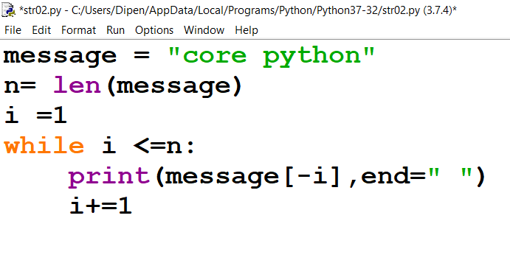
String Traversal

Slide 7
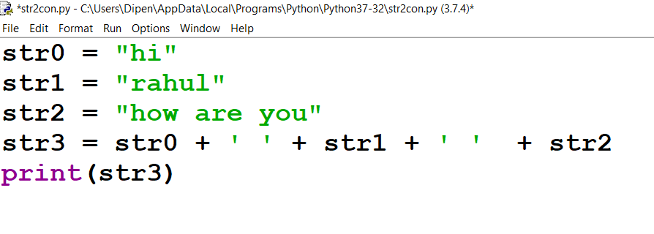
Concatenate two Strings using + operator

Slide 8
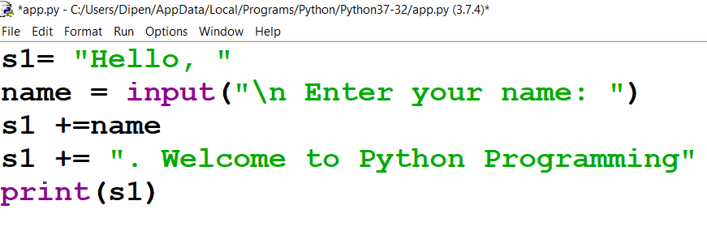
Append a String using += operator

Slide 9
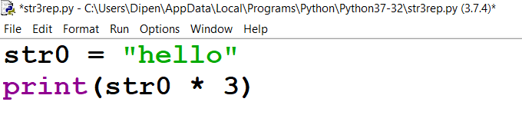
Repeat a String using * operator

Slide 10
Find the output
S1 = “Hello”
var = 7
S2 = S1 + var
print (S1)
????????????????
S1 = “Hello”
var = 7
S2 = S1 + str(var)
print (S1)
????????????????

Slide 11
Strings are immutable
An immutable object is an object whose content cannot be changed.
On the other hand, a mutable object is an object whose content can be changed as and when required.
In Python, numbers, strings and tuples are immutable. Lists, sets, dictionaries are mutable objects.

Slide 12
Strings are immutable
There are two reasons why string objects are made immutable in Python.
Performance: When an object is immutable, it will have fixed size in memory since it cannot be modified. Because strings are immutable, we can easily allocate memory space for them at creation time, and the storage requirements are fixed and unchanging. Hence it takes less time to allocate memory for strings and less time to access them. This increases the performance of the software.
Security: Since string objects are immutable, any attempts to modify the existing string object will create a new object in memory. Thus the identity number of the new object will change that lets the programmer to understand that somebody modified the original string. This is useful to enforce security where strings can be transported from one application to another application without modifications.

Slide 13
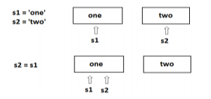
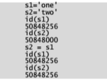
Strings are immutable

Slide 14
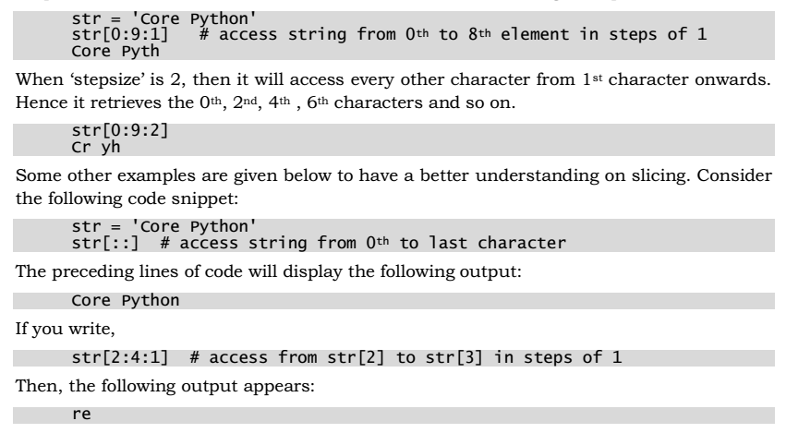
Slicing the strings

Slide 15
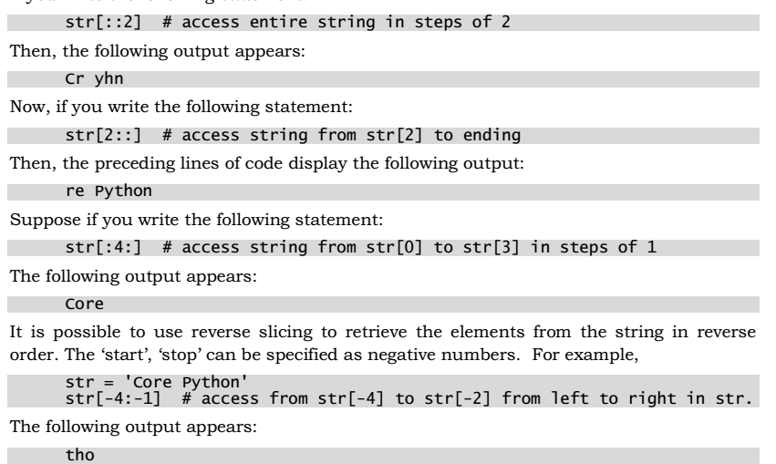
Slicing the string

Slide 16
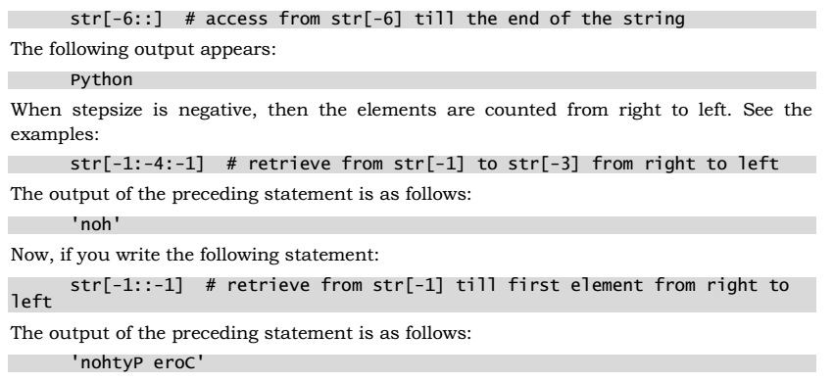
Slicing the Strings

Slide 17
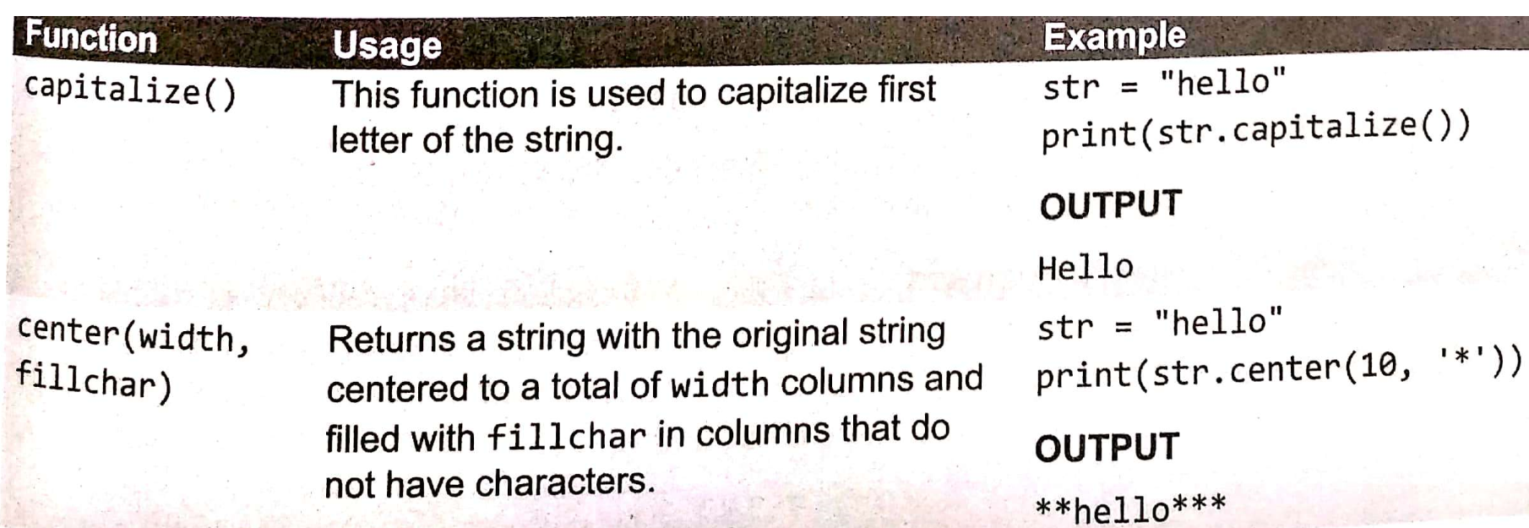
Built In String Methods and Functions

Slide 18
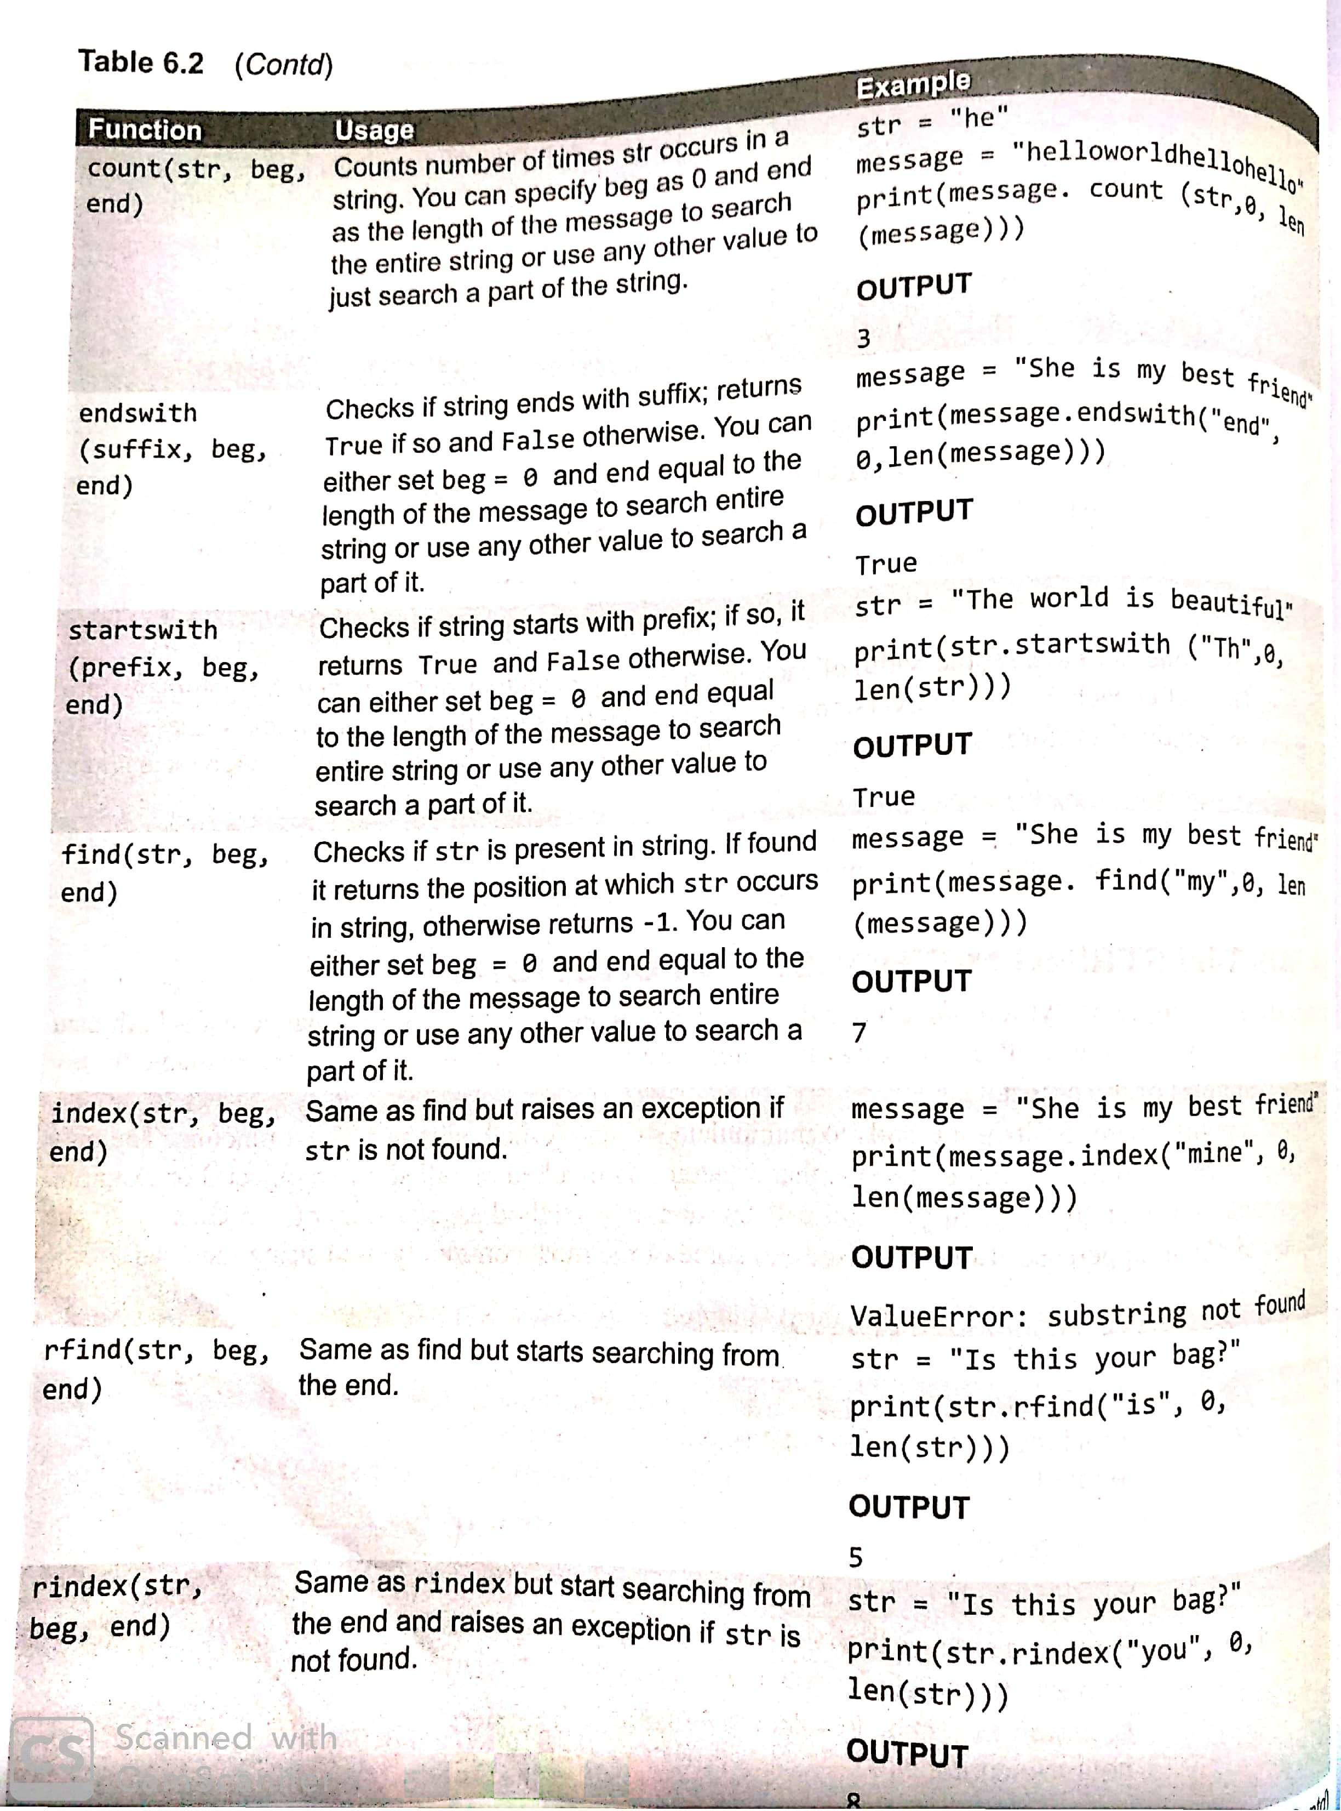

Slide 19
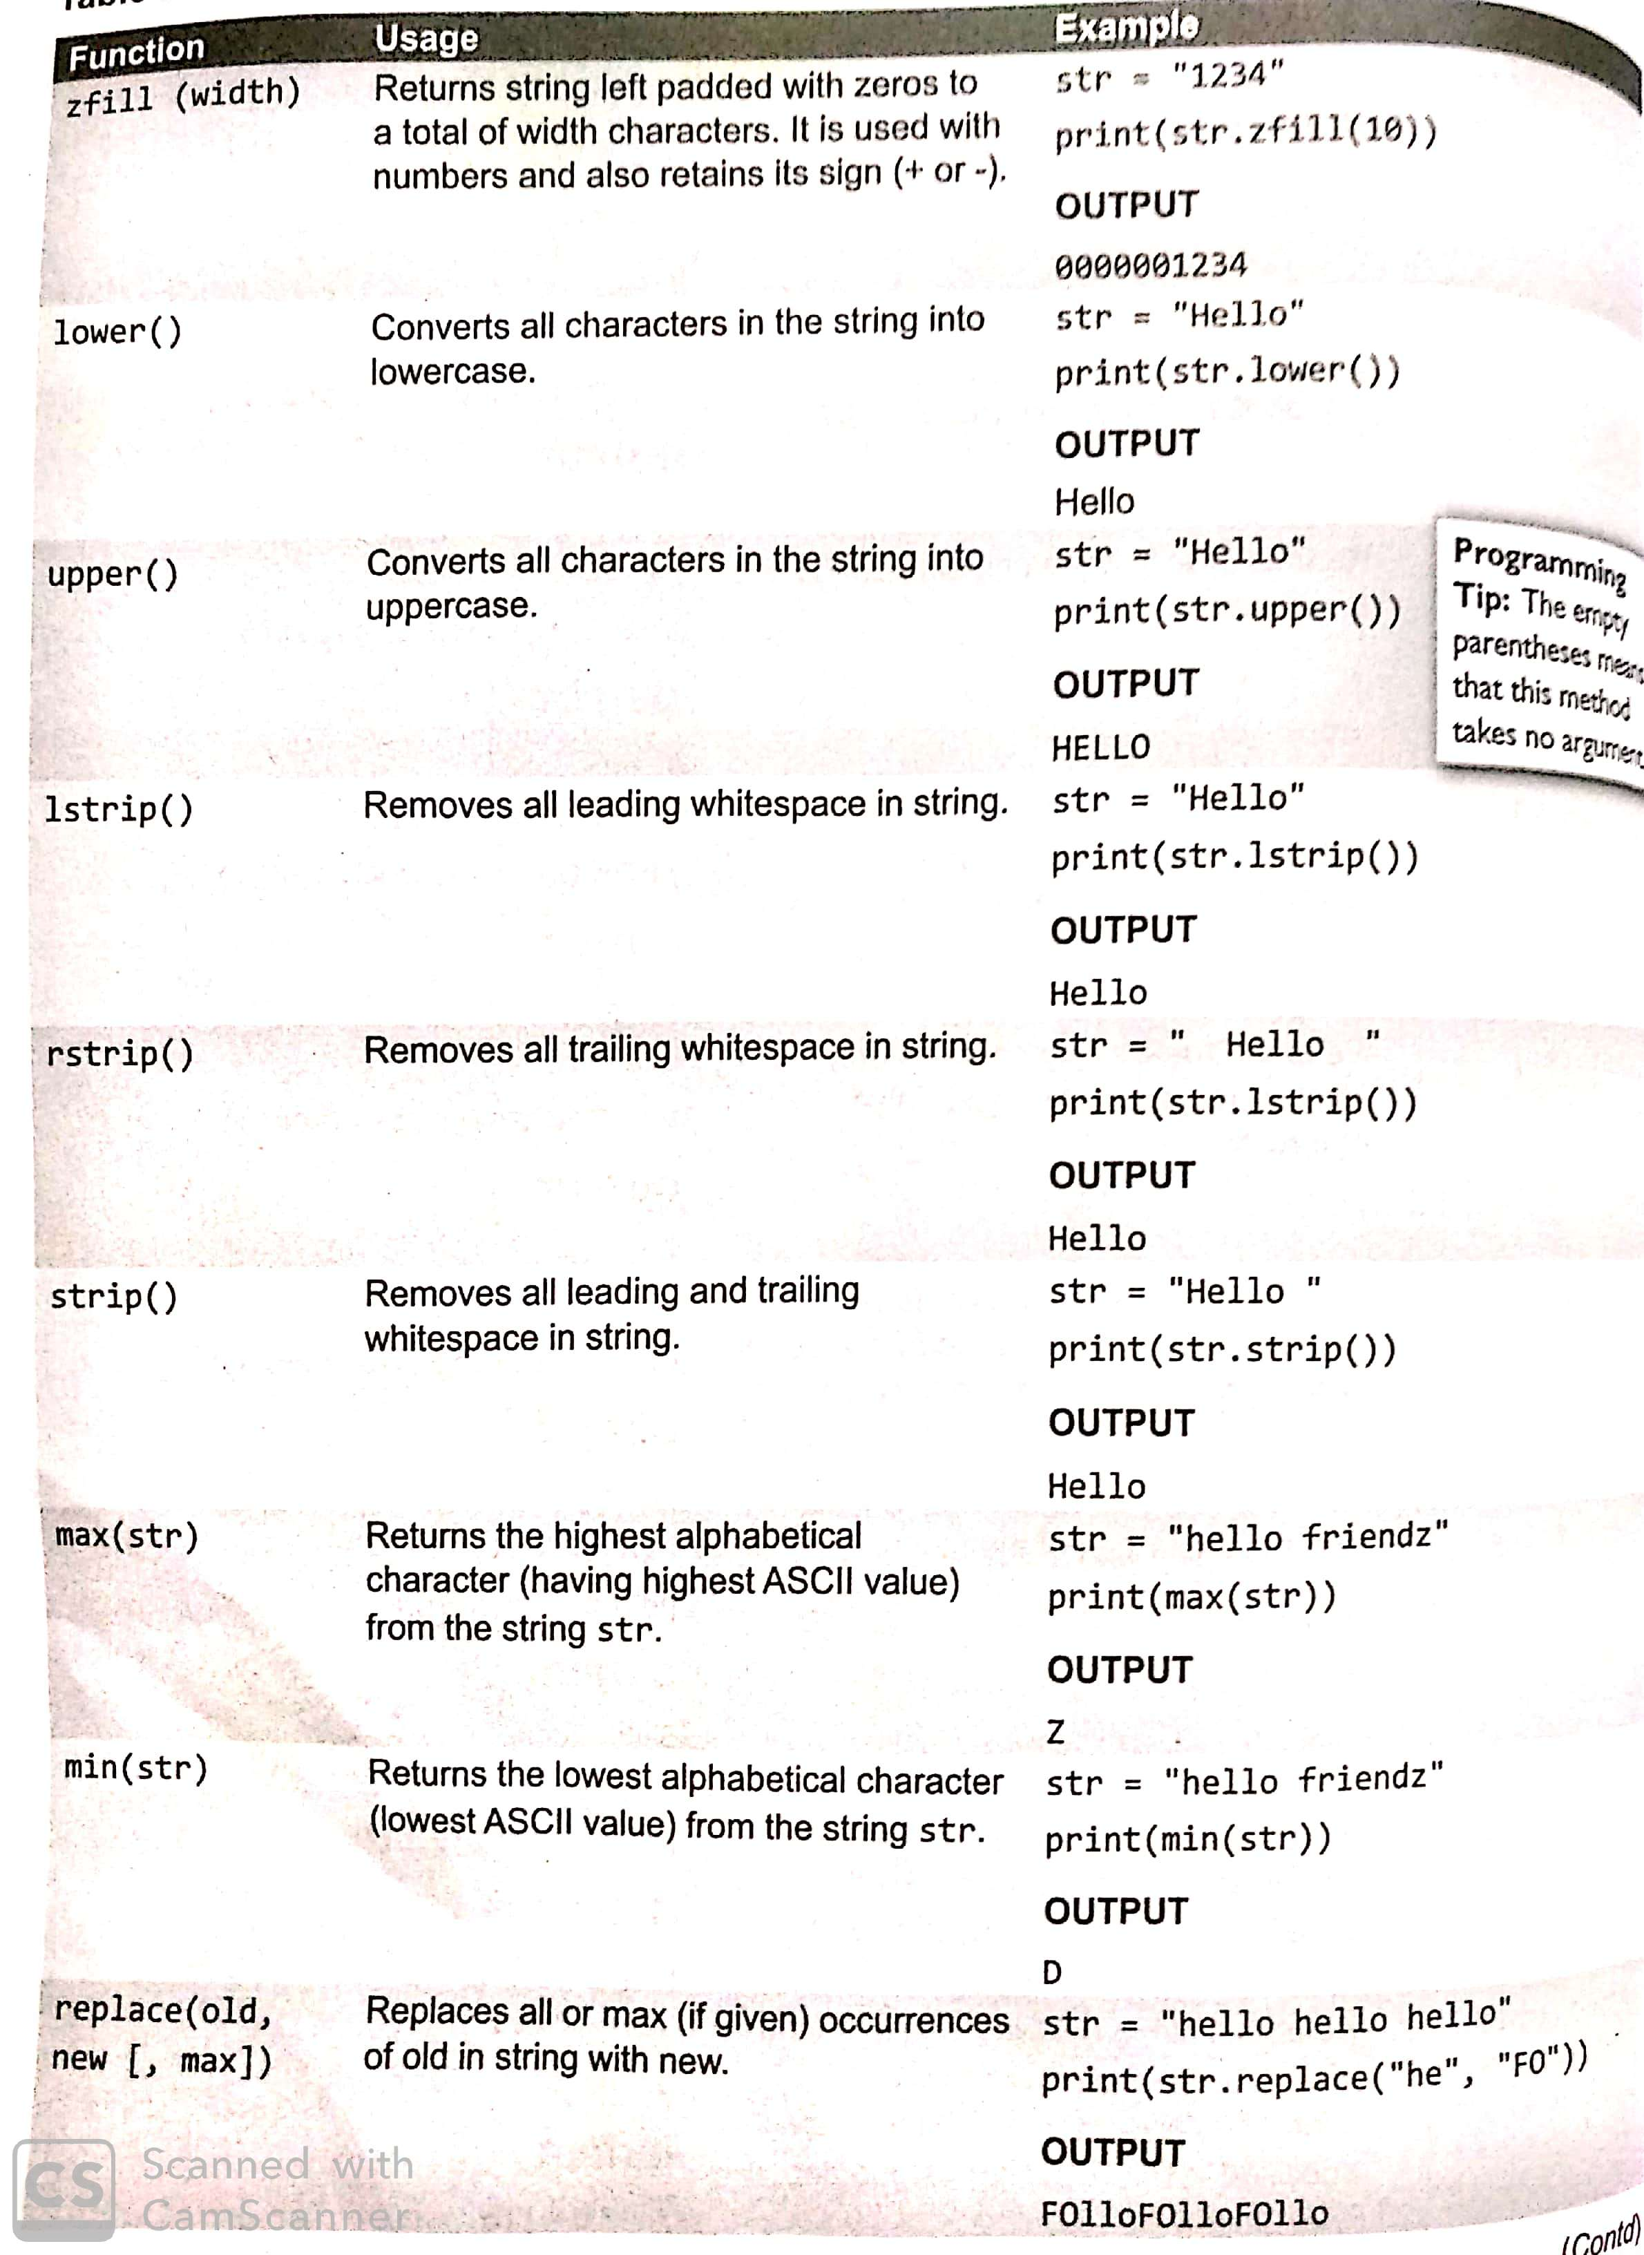

Slide 20
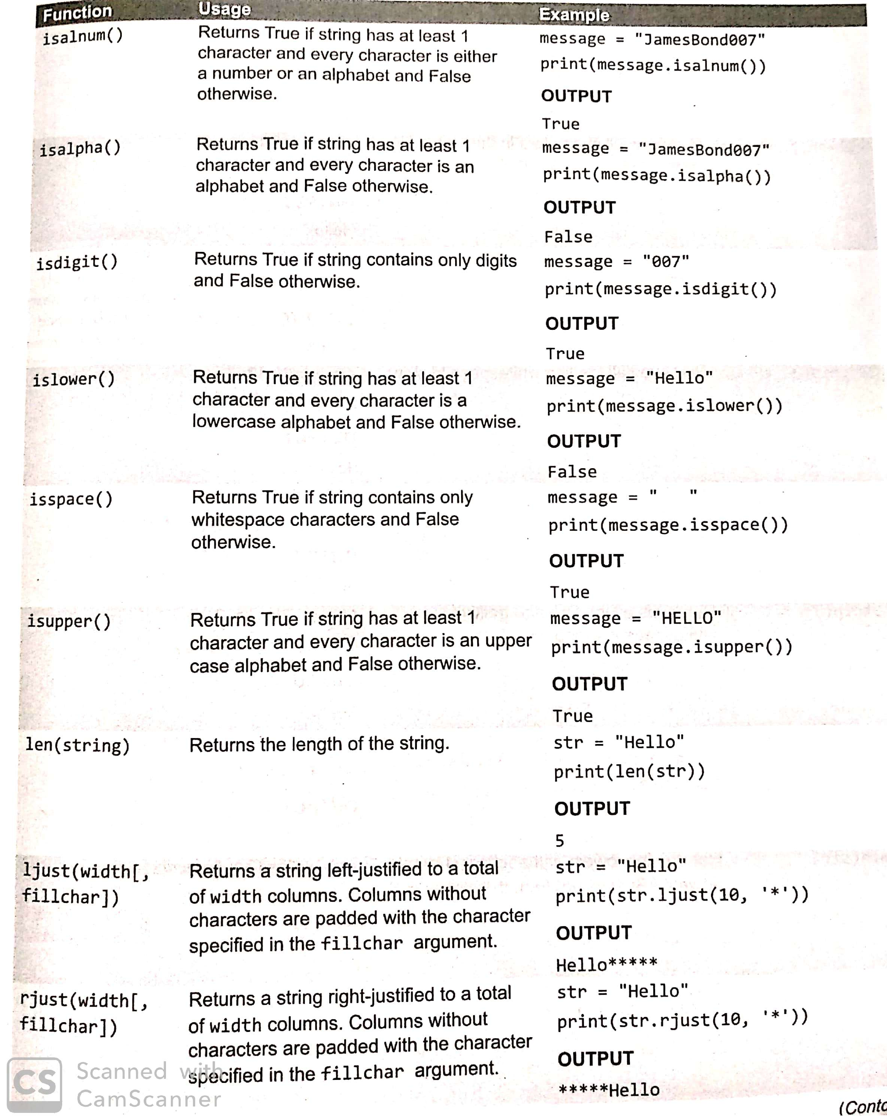

Slide 21
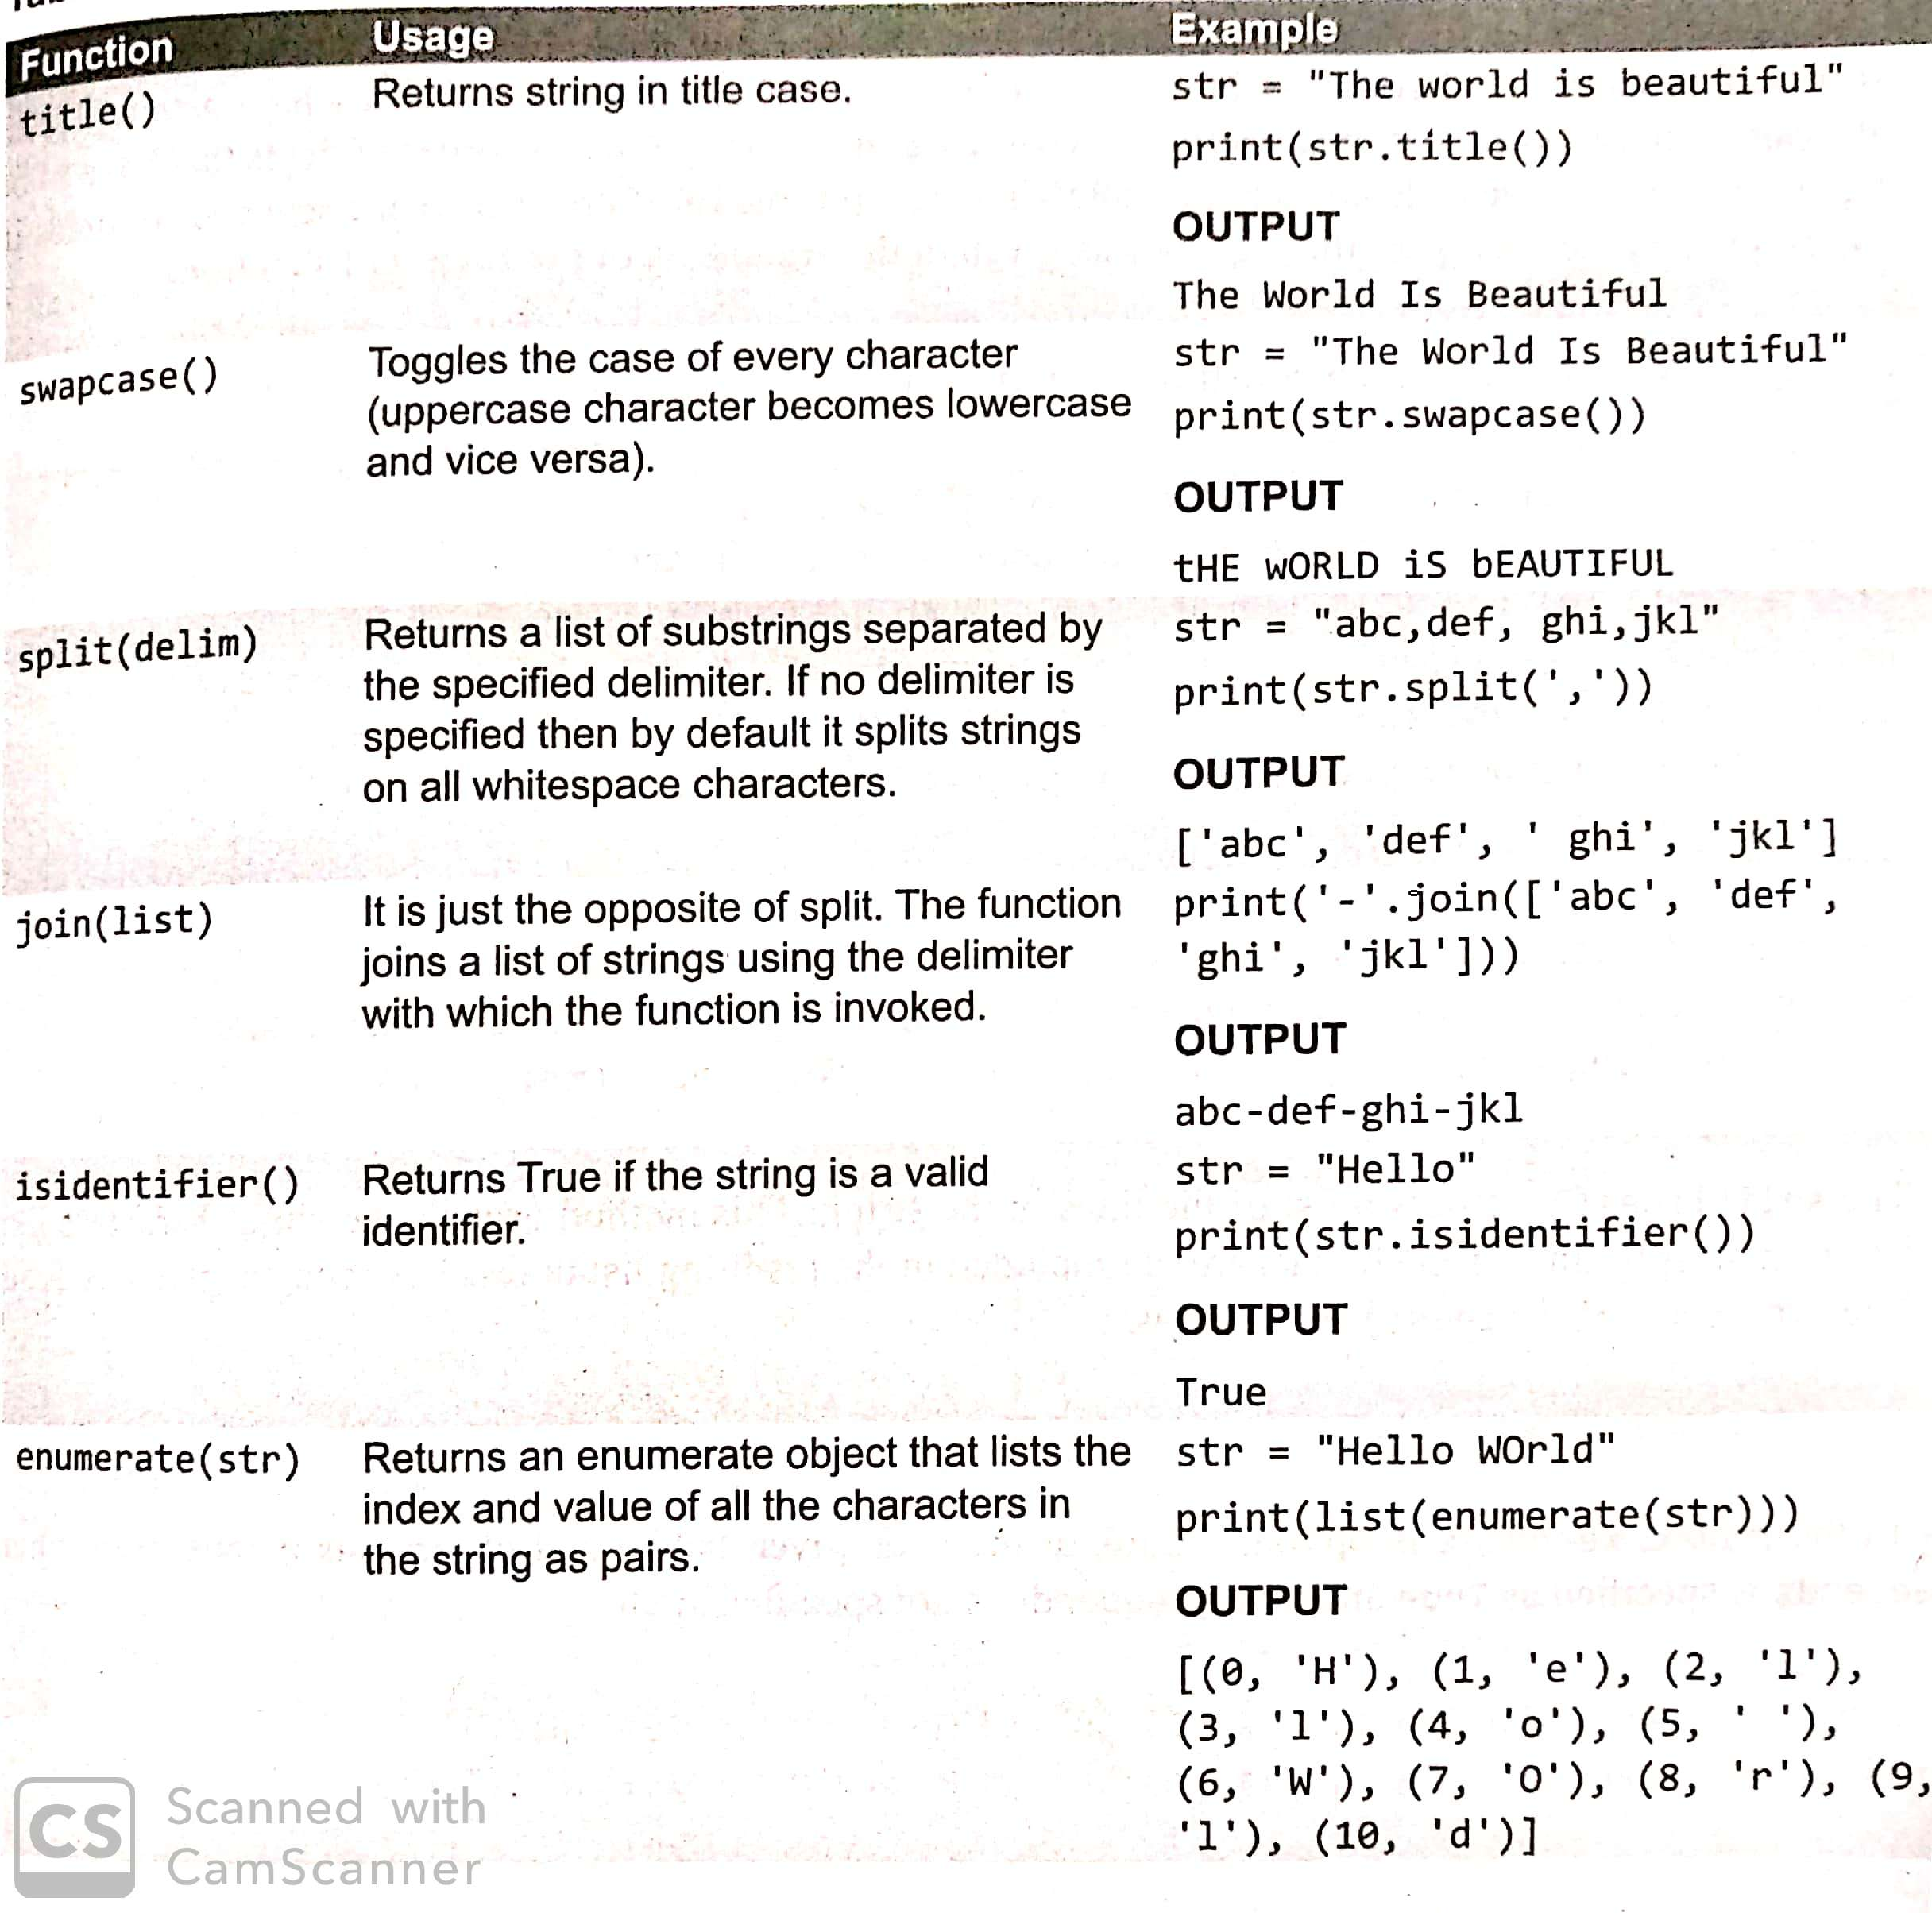

Slide 22
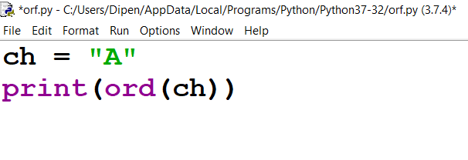
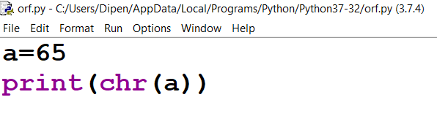
ord( ) and chr( ) functions

Slide 23
Program 1
Print the following pattern
A
AB
ABC
ABCD
ABCDE
ABCDEF

Slide 24
Program 2
Write a program that accepts a string from the user and redisplays the same string removing vowels from it.
Input string
The food is very tasty
Output string
Th fd s vry tsty

Slide 25
Program 3
Write a program that counts the occurrences of a character in a string.
Input
string: Lovely flowers
character: e
Output
In Lovely flower e occurs 2 times

